Slide 1




Course name: Electrical & Electronics System (EE1002)
B.TECH FIRST YEAR
ACADemic YEAR: 2023-2024
Course code : EE 1002
lecture series no : 06 (one)
Credits : 04
Mode of delivery : oFF line (Power point presentation)
Faculty : Mr. ritesh singh
Email-id : ritesh.singh@jaipur.manipal.edu
PROPOSED DATE OF DELIVERY: 16 Aug 2023

Slide 2
Session outcome
“Recall KVL and KCL and apply them to find solution of different dc network problems using Mesh analysis methods”
“Recall KVL and KCL and apply them to find solution of different dc network problems using Nodal analysis methods”

Slide 3
Assessment criteria’S
Assignment
quiz
mid term examination
END TERM EXAMINATION

Slide 4

CO1 mapping with PROGRAM OUTCOMES [po1],[po2], & [po3]

Slide 5
Mesh Analysis & Node Analysis
Lecture No. L8-L9

Slide 6
Contents
Topic:
1. Mesh & Super mesh
2. Node & Super node

Slide 7
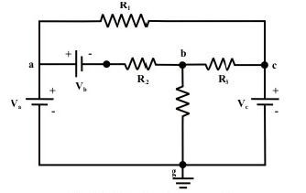
Some basic definitions
Node- A node in an electric circuit is a point where two or more components are connected together.
This point is usually marked with dark circle or dot. The circuit in fig. has nodes
a, b, c, and g.
Generally, a point, or a node in a circuit specifies a certain voltage level with respect to a reference point or node.

Slide 8
Some basic definitions
Branch- A branch is a conducting path between two nodes in a circuit
containing the electric elements.
These elements could be sources, resistances, or other elements.
Fig. shows that the circuit has six branches: three resistive branches (a-c, b-c,
and b-g) and three branches containing voltage and current sources (a-, a-, and
c-g).

Slide 9
Some basic definitions
Loop- A loop is any closed path in an electric circuit i.e., a closed path or loop
in a circuit is a connecting sequence of branches which starting and end points
for tracing the path are, in effect, the same node and touches no other node
more than once.
Fig. shows three loops or closed paths namely, a-b-g-a; b-c-g-b; and a-c-b-a.
Further, it may be noted that the outside closed paths a-c-g-a and a-b-c-g-a are also form two loops.

Slide 10
Some basic definitions
Mesh- a mesh is a special case of loop that does not have any other loops
within it or in its interior.
Fig. indicates that the first three loops (a-b-g-a; b-c-g-b; and a-c-b-a) just
identified are also ‘meshes’ but other two loops (a-c-g-a and a-b-c-g-a) are not.

Slide 11
1 - Mesh & Super Mesh
Mesh Current Analysis
Mesh / loop analysis Principle – KVL
Direction of mesh current is arbitrary and is generally selected based on the voltage source polarity.
Mesh/loop equations are written based on the assumed current directions.

Slide 12
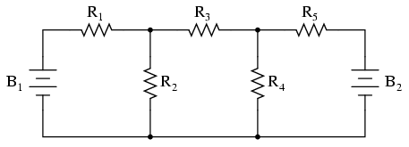
Mesh Current Analysis…..
For the circuit shown, obtain the mesh equations
I₁
I₂
I₃

Slide 13
Exercise
For the circuit shown, determine the mesh currents i_{1 ,}i₂ and current through the galvanometer
[ i₁ = 0.10197A, i₂ = 0.11184A. i_{G} = 9.87 mA]
M1: 40 (i₁) + 100 (i₁ - i₂) + 20 (i₁ – i₃) = 0
M2: 30 (i₂) + 30 (i₂ – i₃) + 100 (i₂ – i₁) = 0
M3: 10 (i₃) + 20 (i₃ – i₁) + 30 (i₃ – i₂) = 10

Slide 14
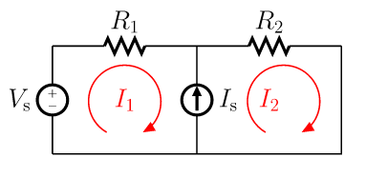

Super Mesh
A super mesh occurs when a current source is contained between two essential meshes.
The circuit is first treated as if the current source is not there.
This leads to one equation that incorporates two mesh currents.
Once this equation is formed, an equation is needed that relates the two mesh currents with the current source.
This will be an equation where the current source is equal to one of the mesh currents minus the other.

Slide 15
Example : Super Mesh
For the circuit shown, determine the current through the 3 ohm resistor
Current through 3 ohm resistor = i₂ – i₃ = 0.5 A (right to left)
1(i₁-i₂) + 3(i₃-i₂) + 1 (i₃) = 7
1(i₂-i₁) + 2 (i₂) + 3 (i₂-i₃) = 0
(i₁ – i₃ )= 7

Slide 16
2 - Node & Super node
Node Voltage Analysis
Node Voltage analysis Principle – KCL
One of the nodes is the reference node
Number of Node equations required = (Total No. of Nodes - 1)
While writing the node equations, it is assumed that the node under consideration is at higher potential to that of other nodes connected to it
The current directions at a node is decided by the above assumption
Transform all convertible voltage sources to current sources, it helps reducing the simplification.
Rearrange the node voltage equations in the form [G][v]=[i]
Solve for [v]

Slide 17
Node Voltage Analysis
For the circuit shown, obtain the node voltage equations
1
2
0; Reference node
Rearranging the terms

Slide 18
Example
For the circuit shown, determine the current through the galvanometer.

Slide 19
Super Node
When a circuit contains voltage sources DIRECTLY connecting two essential nodes,
the concept of the Super node is used to write the necessary nodal equations.
Note that there may be more than one super node in a circuit.
Also, a super node may possibly include more than 2 nodes.

Slide 20
Example : Super Node
For the circuit shown obtain the node voltage V₁
3 (v₁ – v₂) + 4 (v₁ - v₃) = -11
3 (v₂-v₁) + 4 (v₃-v₁) + 5 v₃ + 1 v₂ = 28
v₃ – v₂ = 22
Rearranging the equations
7 v₁ – 3 v₂ – 4 v₃ = -11
-7 v₁ + 4 v₂ + 9 v₃ = 28
v₂ + v₃ = 22

Slide 21
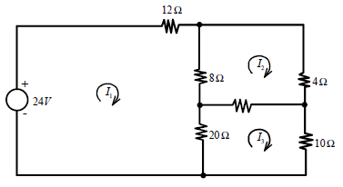
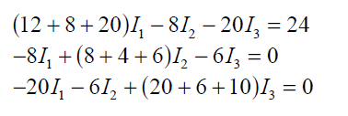
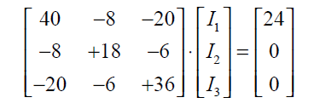
Numerical
Q. Determine the following loop currents.
6𝛺
Sol. We obtain,
How to solve this systems?

Slide 22
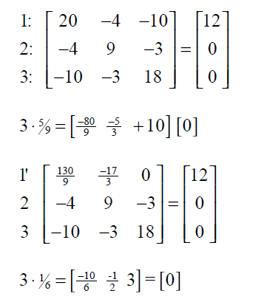
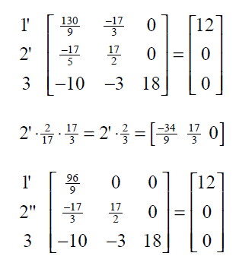

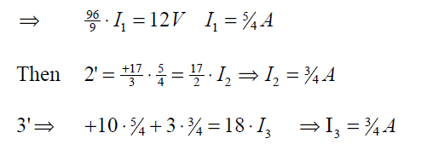
Method 1: Gaussian Elimination to Triangular form

Slide 23
Method 2: Cramer’s Rule
24
0
−8 −20
18 −6
40
−8
−20
24
0
0
−20
−6
36
0 −6 36
I₁
=
I₂
=
40
−8
−20
−8 −20
40
−8
−20
−8
+18
−6
−20
−6
+36
+18
−6
−6
+36
40
−8
−20
−8
18
−6
24
0
0
I₃
=
40
−8
−20
−8
+18
−6
−20
−6
+36

Slide 24
THANK YOU

